Slide 1
Diagnostic and Assumptions Demo
PSY308B Fall 2024

Slide 2
Demo 1

Slide 3
Design
You are a research assistant working with Harvard University on a research study looking at differences in alcohol use between students who affiliated with the Greek system and those who are not.
RQ: Is there a relationship between Greek life affiliation and alcohol use?
H1: Affiliation with Greek life is positively related to alcohol consumption.
Greek Life
Alcohol
Consumption
A
A
I
S
C
H
D
D
P
E
H1

Slide 4
Design
You survey the student body (n=4,445) and ask them to report their Greek life involvement (Greek = 1, Not Greek = 0) as well as their gender, year in school, and number of drinks consumed in the last 30 days.
Outcome Variable: Alcohol Consumption
Operationalization: # of drinks in the past 30 days
Predictor Variable: Greek Affiliation
Operationalization: Yes or No
Drinks Consumed = Greek Life + Error
A
A
I
S
C
H
D
D
P
E
Our Model

Slide 5


Investigate
Data Features that Impacts your Model Performance
Floor and Ceiling Effects
Range Restriction
Outliers
Missing Data
In an independent T test, this is called homogeneity of variance. Because we pool the variances of each group, they can’t be significantly different from one another
Statistical Assumptions of Your Model
Linearity (& additivity)
Independence of Residuals
Homoscedasticity
Normality (Residuals are normally distributed)
Univariate Normality of the DV for each group
Multivariate Normality
Lack of extreme collinearity amongst predictors
A
A
I
S
C
H
D
D
P
E

Slide 6
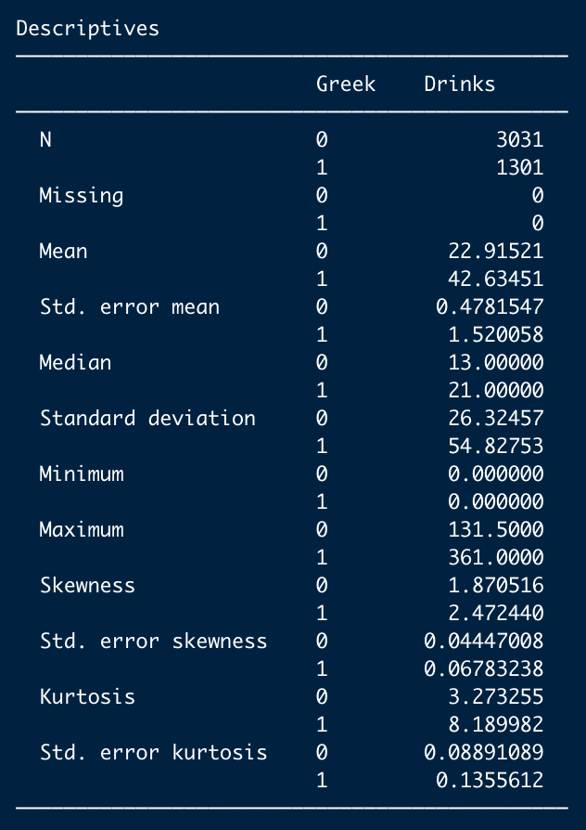
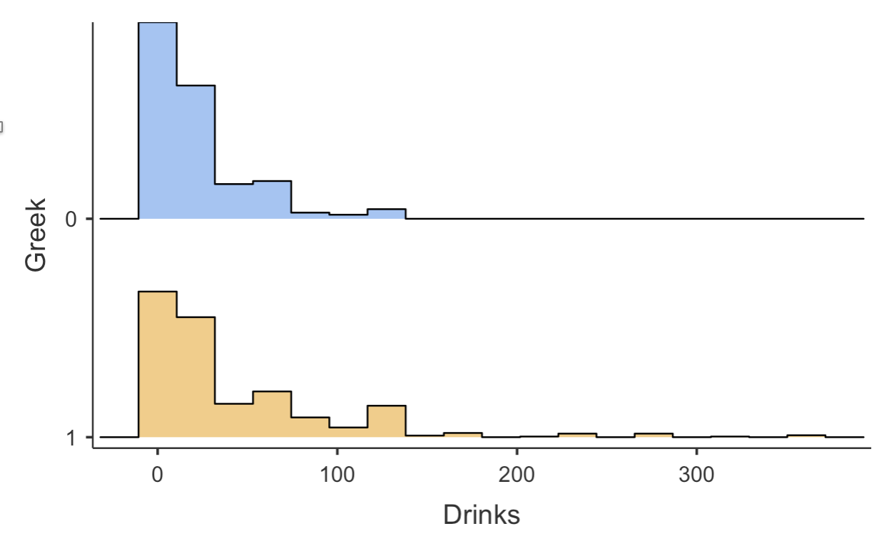
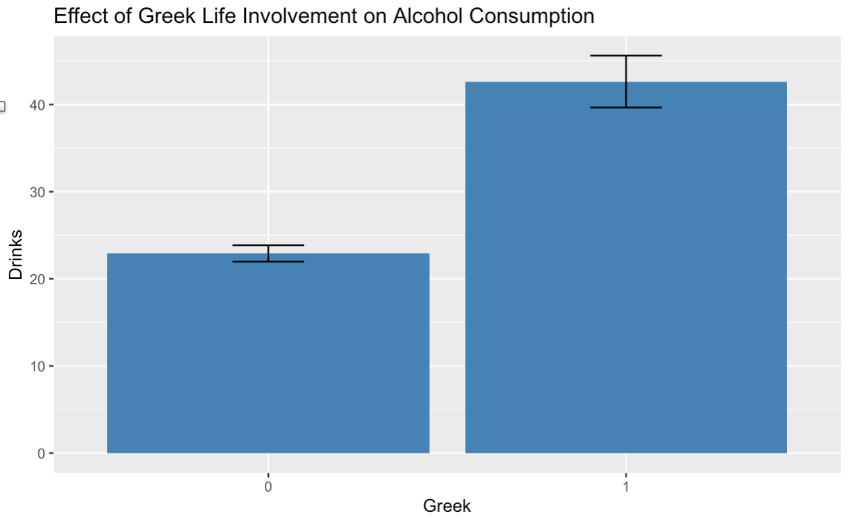
Investigate
Missing Data
Normality
Outliers
Homogeneity of Variance
A
A
I
S
C
H
D
D
P
E

Slide 7
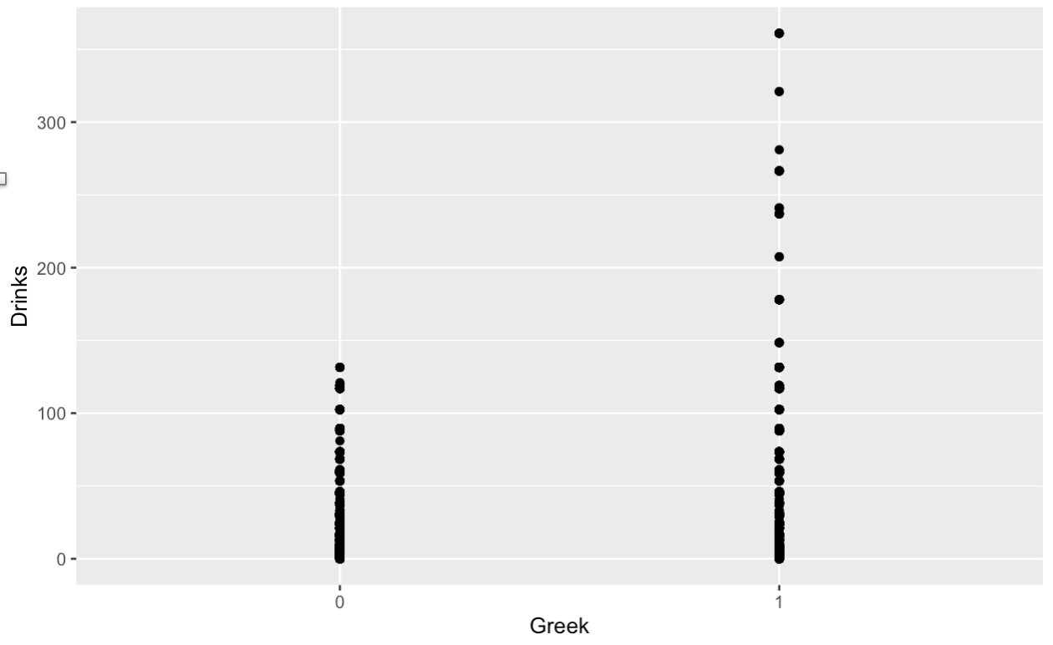
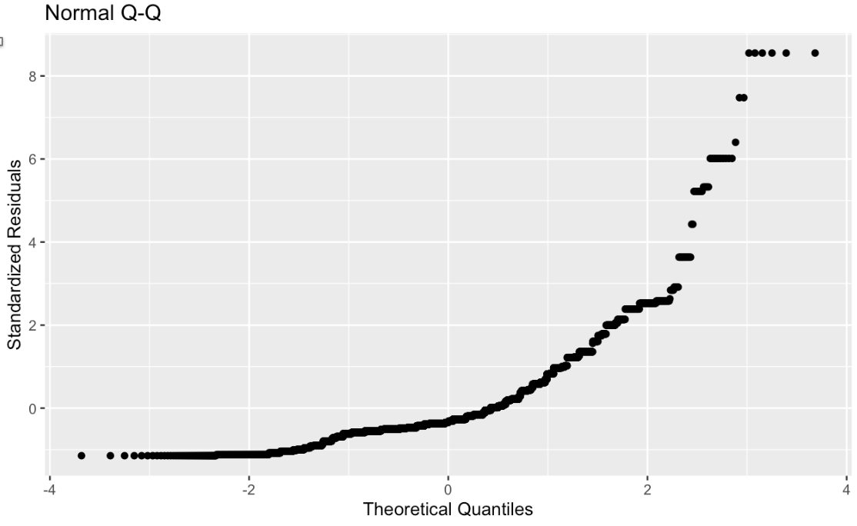
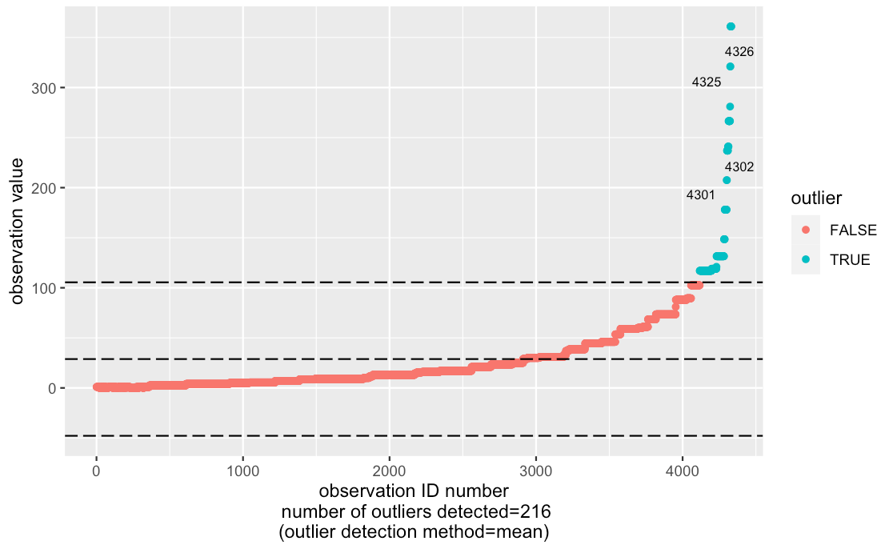
Investigate
Linearity
Normality
Outliers
Design
Investigate
Conclude
Evaluate
Specify
Tell the World!

Slide 8
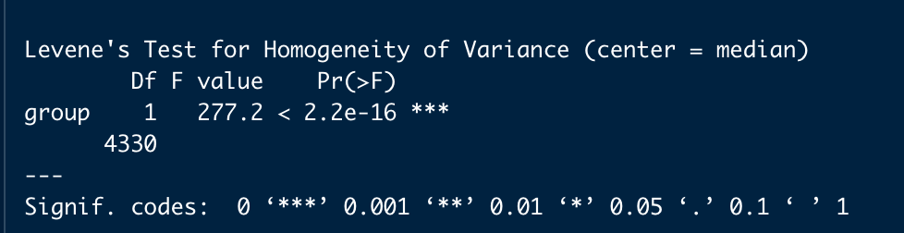
Investigate
Homoscedasticity
The general linear model assumes that the variance of the residuals is constant (e.g. not dependent on levels of the predictor)
Homogeneity of Variance
The name for the homoscedasticity assumption In an independent t-test.
Because the variance of the two groups are pooled, we assume those variances to to be equal. When this is not the case, particularly with unequal sample sizes, it can result in Type I or Type II error.
How to Check
You can see hints of this in the histograms and descriptive data. To test, run a homogeneity of variance test (Levene’s Test) which determines whether the variance of the two groups are significantly different from one another. H₀: variance_{A} = variance_{B}

Slide 9

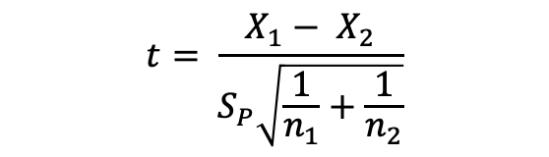


Welch’s T Test
There are two differences in how the Student’s t-test and Welch’s t-test are carried out:
The test statistic
The degrees of freedom
Student T
Welch’s T
$$df= \frac{{(\frac{s_{1}^{2}}{n_{1}}+\frac{s_{2}^{2}}{n_{2}})}^{2}}{\frac{{(\frac{s_{1}^{2}}{n_{1}})}^{2}}{n_{1}−1}+\frac{{(\frac{s_{2}^{2}}{2})}^{2}}{n_{2}−1}}$$
$$t= \frac{X_{1}− X_{2}}{S_{P}\sqrt{\frac{1}{n_{1}}+\frac{1}{n_{2}}}}$$
$$t= \frac{X_{1}− X_{2}}{\sqrt{\frac{s_{1}^{2}}{n_{1}}+\frac{s_{2}^{2}}{n_{2}}}}$$
$$df= n_{1}+ n_{2} −1$$

Slide 10
Write Up
An independent t test was used to determine whether students affiliated with the Greek system consumed significantly more alcoholic drinks per month than those who were not affiliated. After removing 50 participants whose drinks consumed was more than 3 standard deviations from the mean, the final sample consisted of 4,282 students, 1,251 affiliated students and 3,031 not affiliated.
Examination of scatterplots confirmed the data met the assumption of linearity. Although data appeared slightly skewed, skew and kurtosis of the outcome variable for both groups were within |3| and |10| respectively, confirming data were sufficiently normally distributed for analysis.

Slide 11
Write Up
However, a Levene’s test confirmed the data violated the homogeneity of variance assumption, F(1, 4280) = 152.36, p <.001. Accordingly, a Welch’s t-test was used to analyze the difference in group means.
The Welch’s t test confirmed that students affiliated with Greek life (M = 34.87, SD = 37.32) drank significantly more than unaffiliated students (M = 22.92, SD = 26.32), t(1785.09) = 10.32, p < .001, d = 0.37. This was a small to moderate effect, students affiliated with the Greek system drank approximately a third of a standard deviation more than unaffiliated students.

Slide 12
Demo 2

Slide 13
Design
A large organization is interested in implementing a well-being program to help address employee stress levels. Before spending the money required to implement the program org-wide, they decide to run a pilot with 100 participants. They recruit 100 employees to participate in the quarter long program and measure their stress before and after completion. You are interested in determining whether or not the organization should offer the program org-wide.
RQ: Does the organizational well-being program impact stress levels?
H1: Stress levels will decrease following participation in the wellbeing program
Well Being Program
Stress Levels
H1

Slide 14
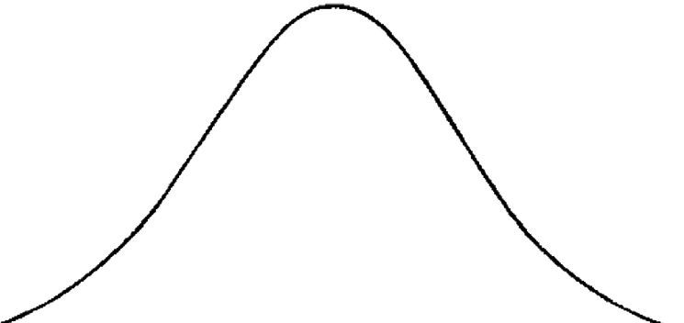



Investigate
Statistical Assumptions of Your Model
Linearity (& additivity)
Independence of Residuals
Homoscedasticity
Normality (Residuals are normally distributed)
Univariate Normality of the Difference Scores
Multivariate Normality
Lack of extreme collinearity amongst predictors
A
A
I
S
C
H
D
D
P
E
Normality: The distribution of difference scores should be normally distributed
Independent T Test
Dependent T Test
$${\overline{\text{X}}}_{Play}$$
$${\overline{\text{X}}}_{\text{Control}}$$
$${\overline{\text{X}}}_{D}$$

